Slide 1
The road to a Service Oriented Architecture
is paved with a message based infrastructure
Notes:
Welcome
Shall we start?
what about lunch

Slide 2
Mauro Servienti
Solution Architect @ Particular Software, makers of NServiceBus
mauro.servienti@particular.net
@mauroservienti

Slide 3
All I want to do when I wake up in the morning is…
(cit. Rosanna, Toto, Toto IV)

Slide 4
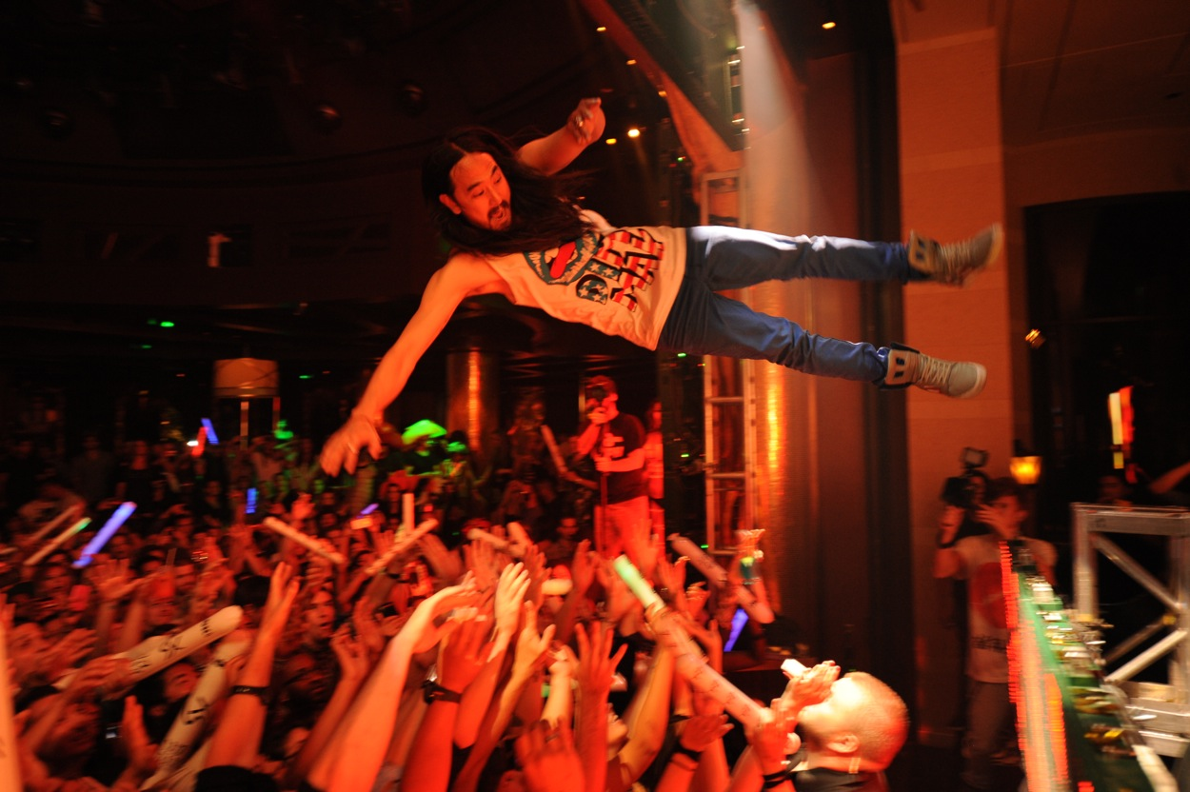
Tickets web site
Buy a ticket
Stage dive… :-)

Slide 5
All what they want to do is…

Slide 6

Display available tickets
Reserve with the theater
Charge my credit card
Deal with their stuff
Deal with insurance
Ship tickets

Slide 7
Sometimes order is important…
Sometimes not

Slide 8
spot the
ISSUE

Slide 9
Multiple resources --
Multiple owners

Slide 10
Transaction boundaries
user perspective: single operation
ticketing system perspective: multiple operations
That should be “atomic”
The business TX crosses multiple boundaries
Theater reservation
Credit card
Insurance
Shipping
Internal stuff
End we’ll end up in a…

Slide 11

SOA
Boundaries
are explicit
…big ball of mud…
When crossing service boundaries
we cannot expect transactions to work

Slide 12

DTC forget you must
Compensation you should welcome
Idempotency your best friend is

Slide 13
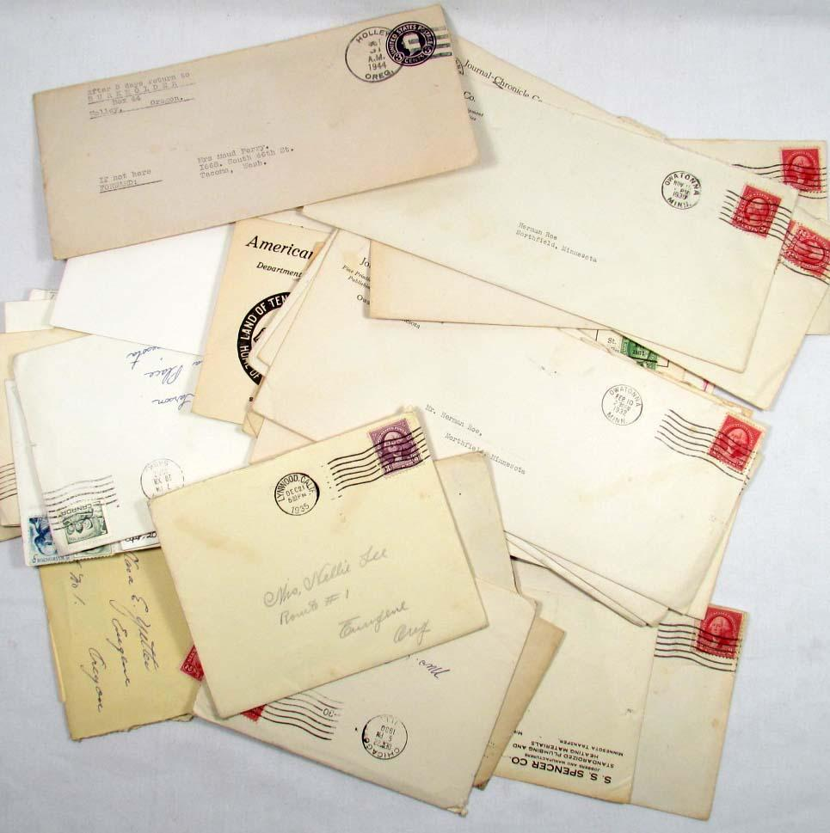
Easily implements Ledger
semantic
Messages are Atomic
Messages are Unique
Messages you want

Slide 14
Messaging Patterns
Because not all communication is born equal

Slide 15

Request/Response
message sent to someone
we know each other
implies some coupling

Slide 16
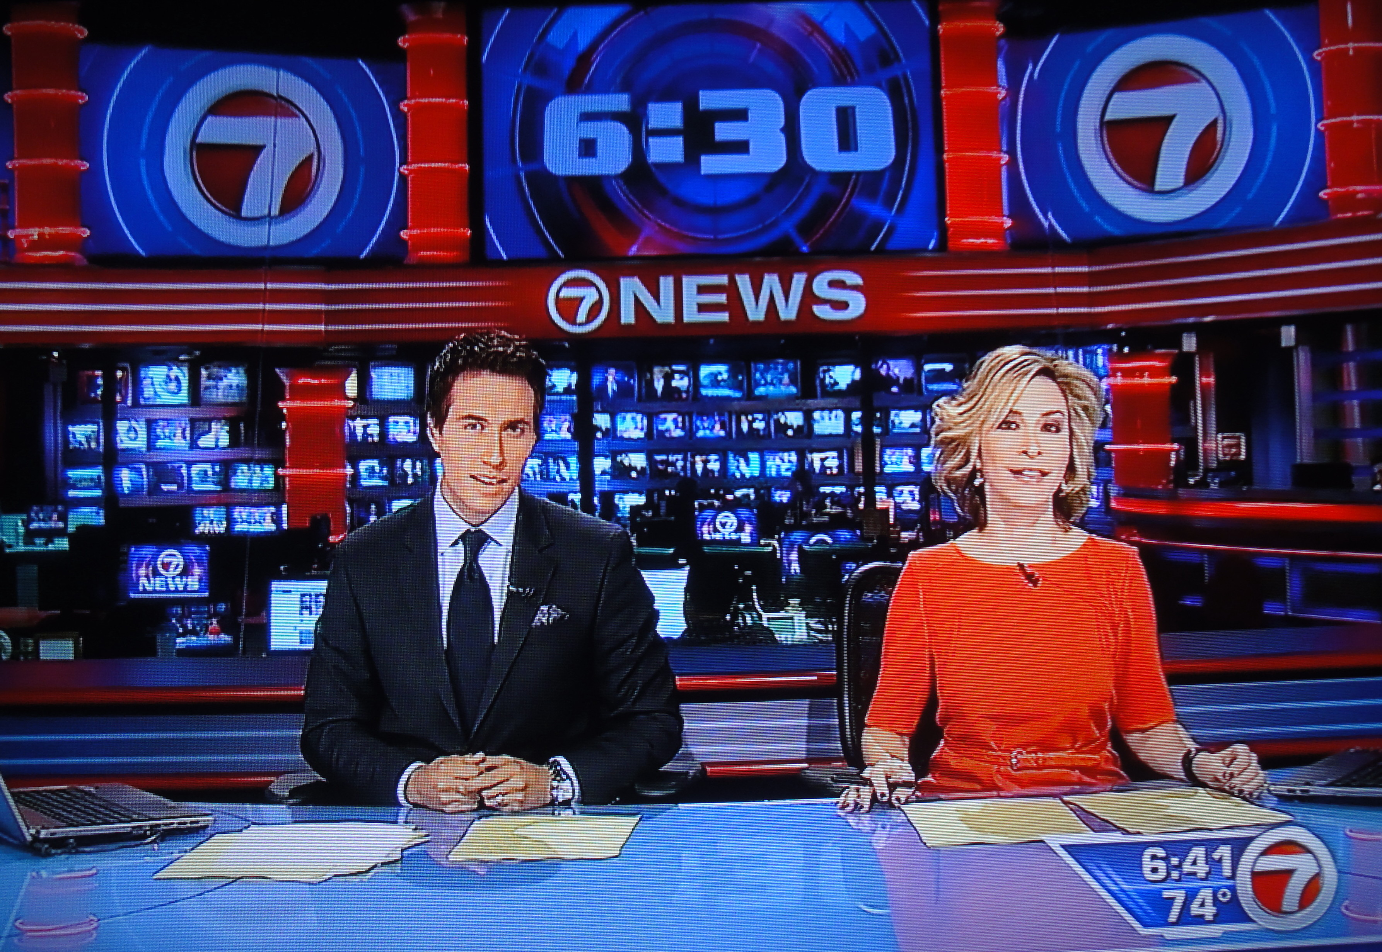
Pub/Sub
broadcasted event, in the past
subscribers know the publisher
implies less coupling

Slide 17
Buy ticket
Reserve Tickets
Order management service
Tickets reservation service
Tickets reservation service
Tickets reservation service
Ticket reserved
Marketing service
Other stuff
Order management service
Credit Card service
Charge Card

Slide 18
Messages in a nutshell
Less coupling
respect your boundaries
No temporal coupling
messages are asynchronous
Much less maintenance/deployment headaches
autonomous components
Easy scale-out
competing consumers
Guaranteed delivery
with error management

Slide 19
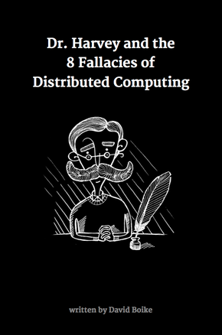
Do you want more?
Free e-book available at:
http://go.particular.net/cloudconfE

Slide 20
Thank you
Go! SOA-fy your world

